Slide 1
Luminus Solutions
Iteration 2 Presentation

Slide 2
Team Structure
Name | Role
Nonhlanhla Mabuza | Project Manager
Ashely Gardner | Analysis
Nicolan Reddy | Analysis
Lwando Sobekwa | Design
Sinako Cetyiwe | Design
Shana-Michelle Rabonda | Implementation

Slide 3
Purpose
Creation of Micro- Tourism Application
Illustrate the build up from Iteration 1

Slide 4
Micro-tourism
Concerned with developing simple solutions which utilize the strengths of the environment within the local area to overcome the lack of utilities that are taken for granted
Siyakhula Living Lab- ‘we are growing together’
Luminus Solutions aims to facilitate the process of joining the Dwesa community with the greater South African community by developing a mobile android front-end for micro tourism

Slide 5
Stakeholders
Siyakhula Living Lab
Reed House Systems
Teleweaver
Dwesa Community
KwaWendy’s Homestay

Slide 6
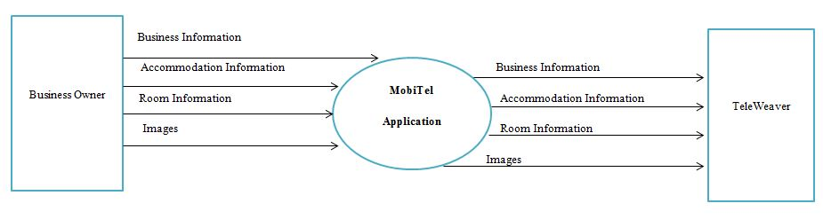
Context Diagram

Slide 7
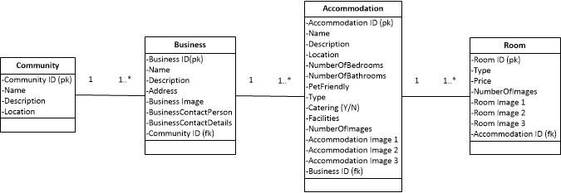
Class Diagram

Slide 8
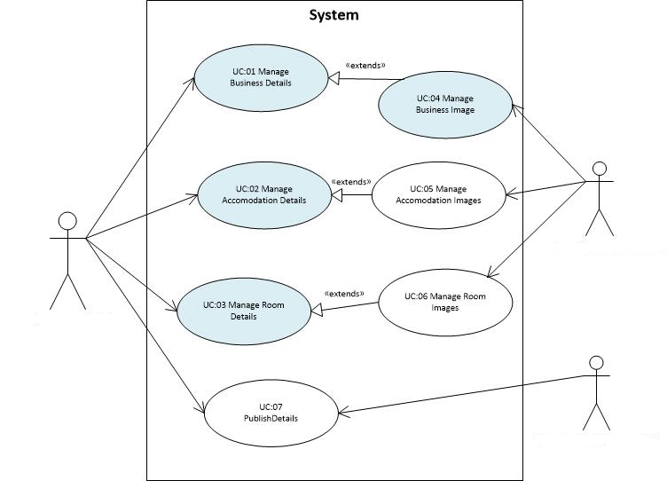
Use Case Diagram
A01: Business Owner
A01: Business Owner
A02: TeleWeaver

Slide 9
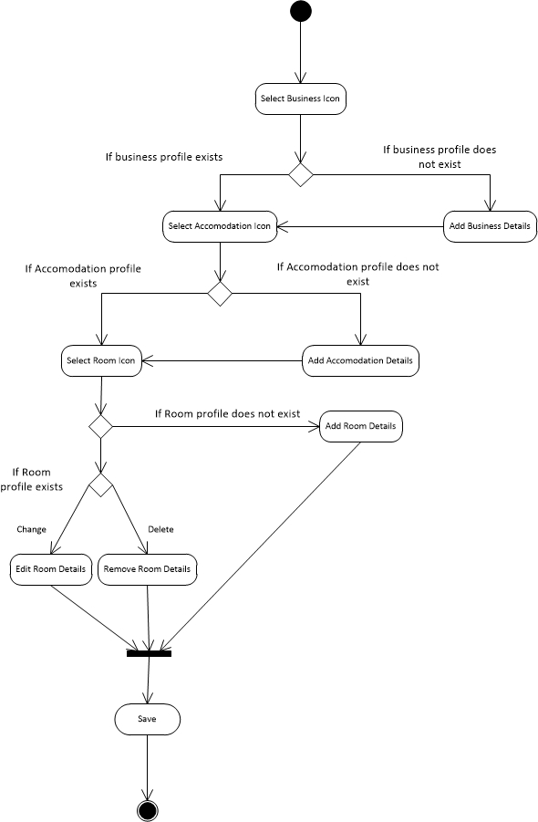
Activity Diagram
Use Case 03: Manage Room Details

Slide 10
Storyboard

Slide 11
Screen Shots ?

Slide 12
Challenges
Contacting Clients
Scope of the application

